Slide 1
Images related to SESC:
Gas puncture device for GASC (smaller version of SESC)
5/11/2018

Slide 2
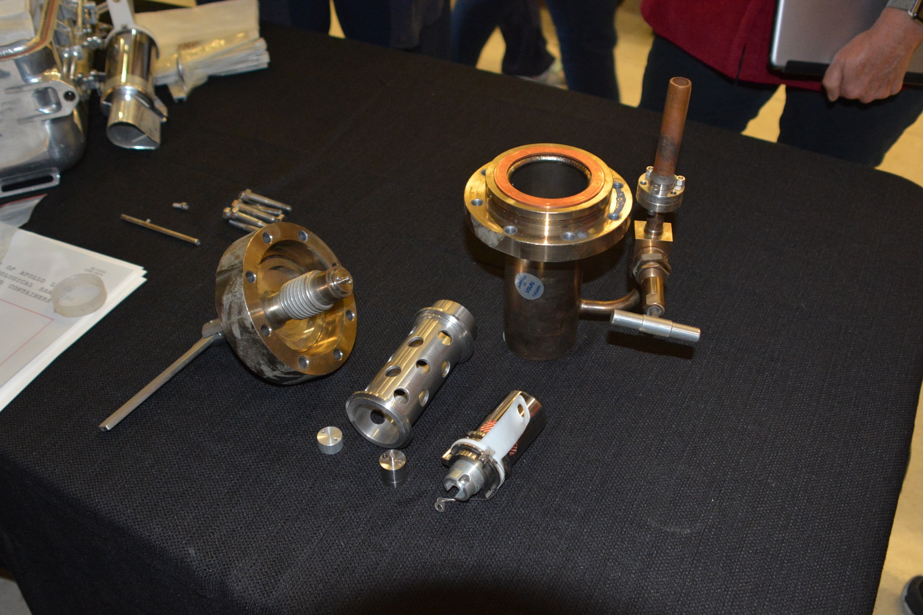
Puncture device used on GASC: Puncture tip circled in red. GASC circled in blue

Slide 3
Puncture device used on GASC: Device assembled, GASC circled in blue

Slide 4
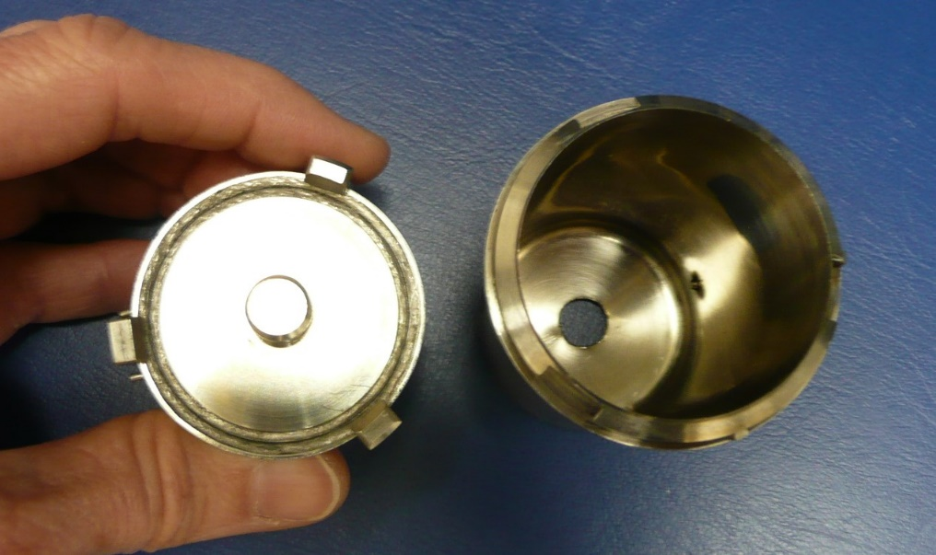
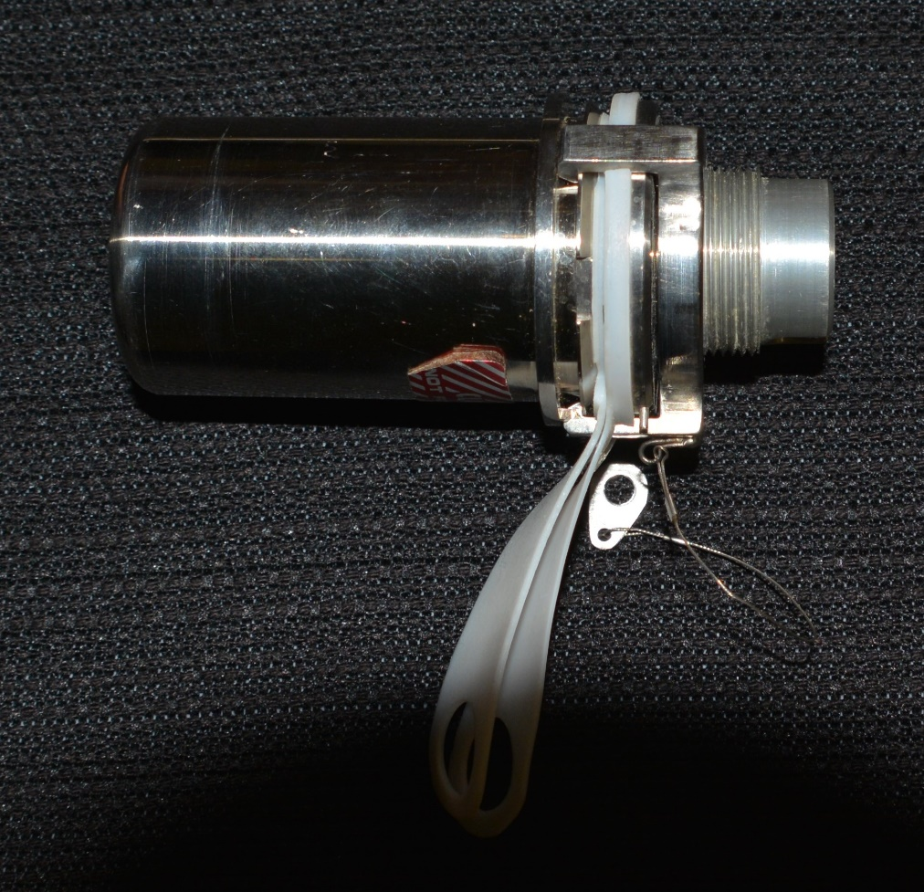
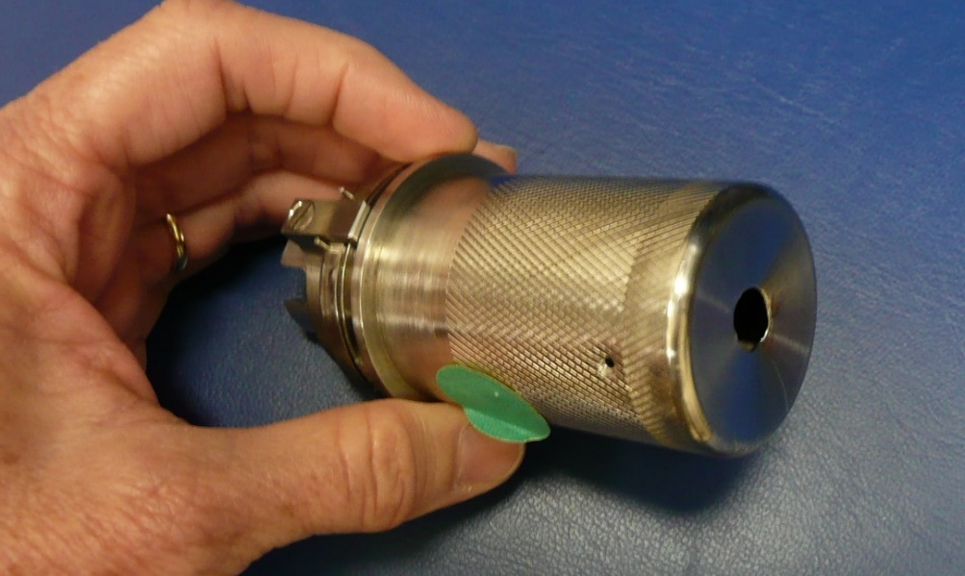
GASC as closed before use to collect sample, showing seal protectors (black background). GASC opened at sealing surface (upper right), punctured bottom (lower right) by use of device

